Slide 1
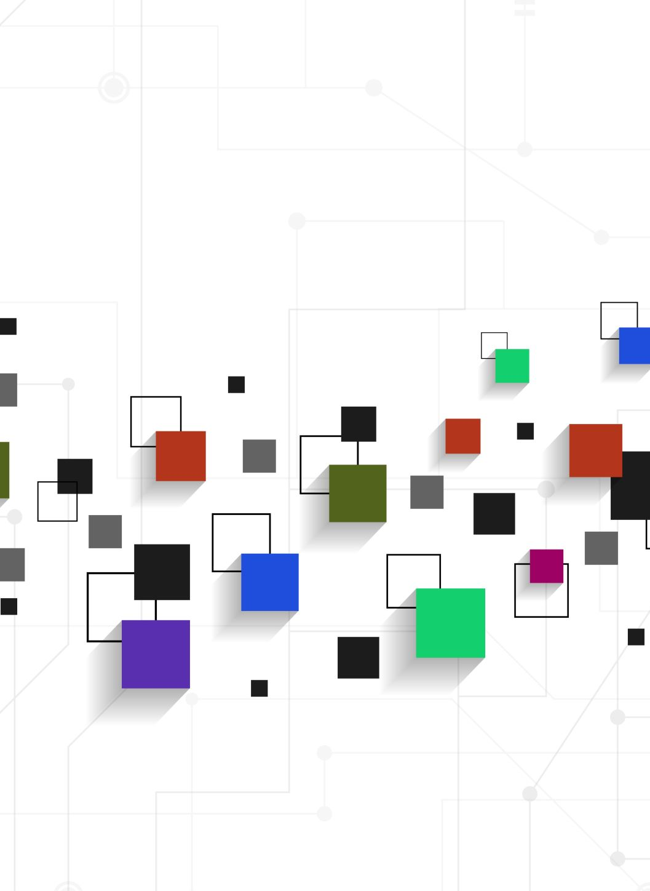
Poker Recognize
Jeng-Hsun Ho, Luis Hsu

Slide 2
Overview
Goal: Recognize poker cards from a test image
Problem scenario: To develop an application that analyzing the status of a poker game, recognition is needed.
Solution: Develop a poker cards recognition technique that can be used in further applications.

Slide 3
Implementation
Create Mask
Blur
Match template
SIFT Detection
Recognize
Recognition Matrix
FLANN matcher
Canny Edge
Get contours
Split RGB channels

Slide 4
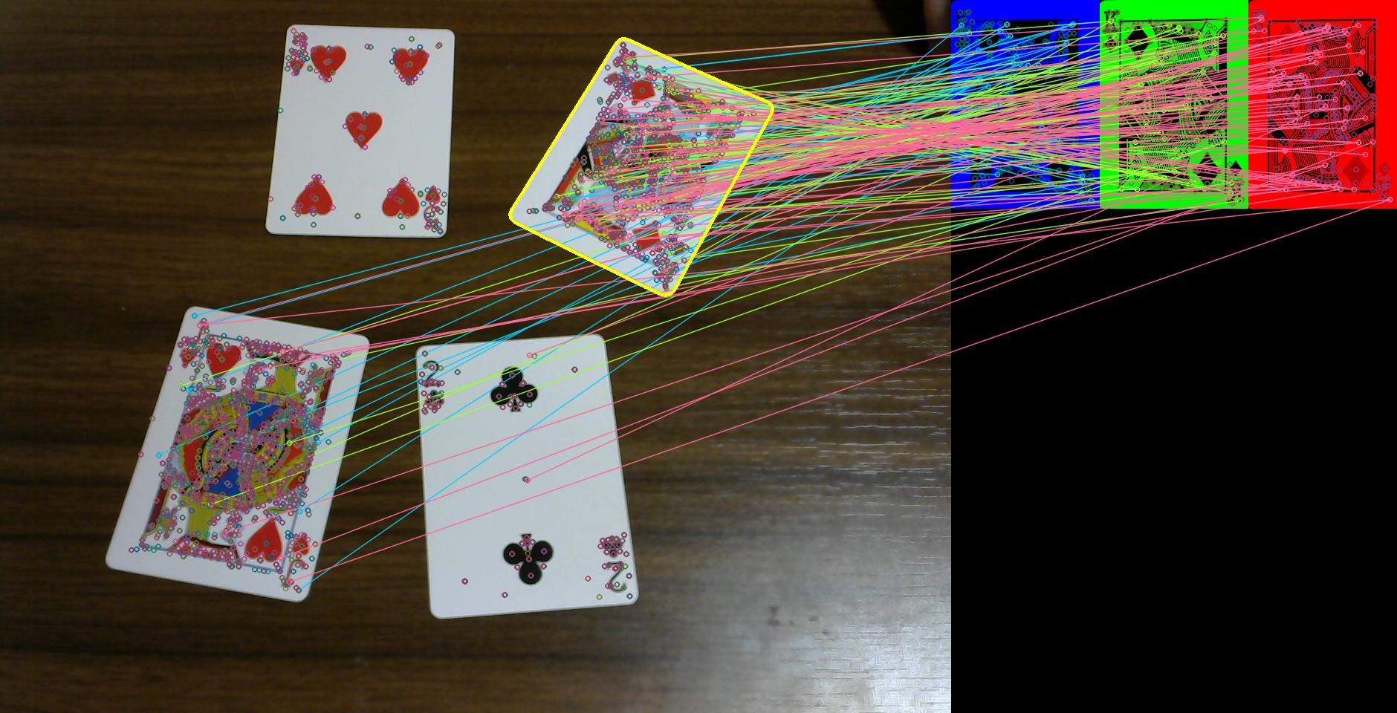
Result

Slide 5
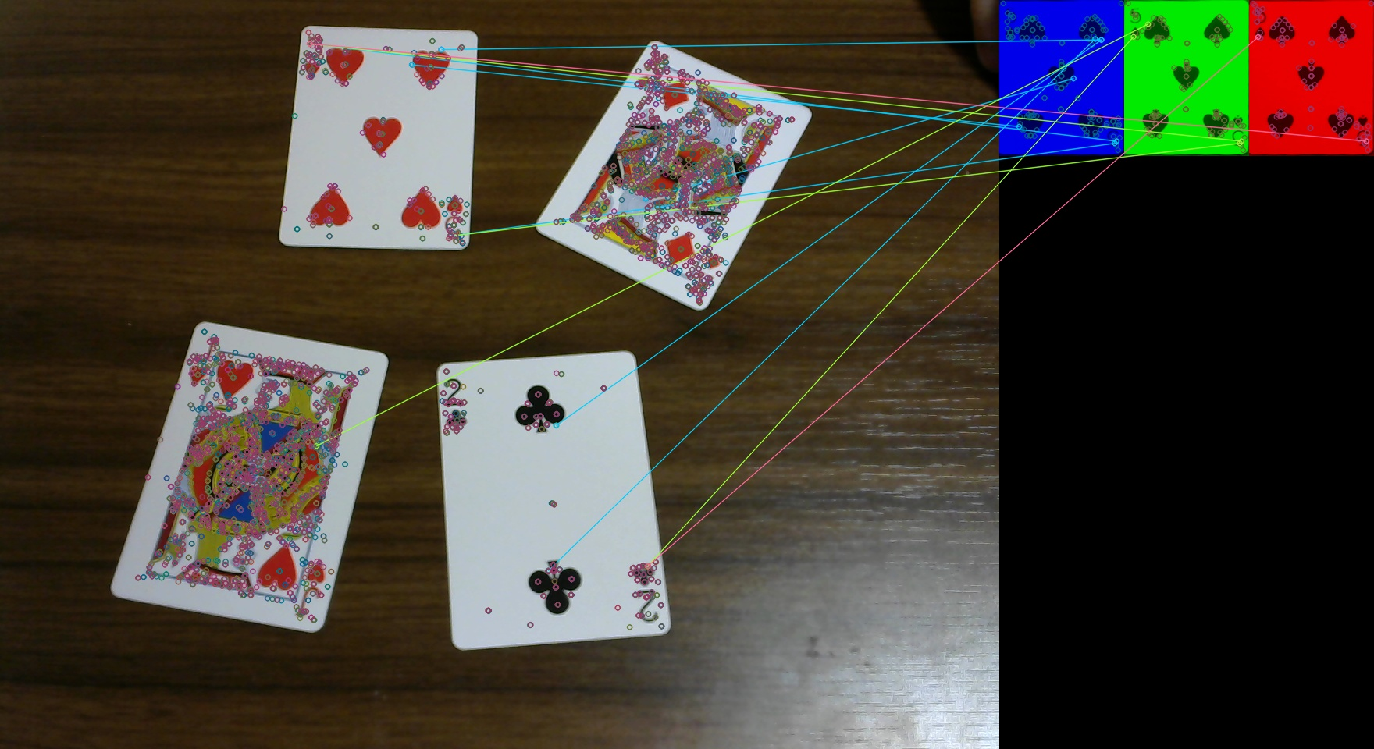
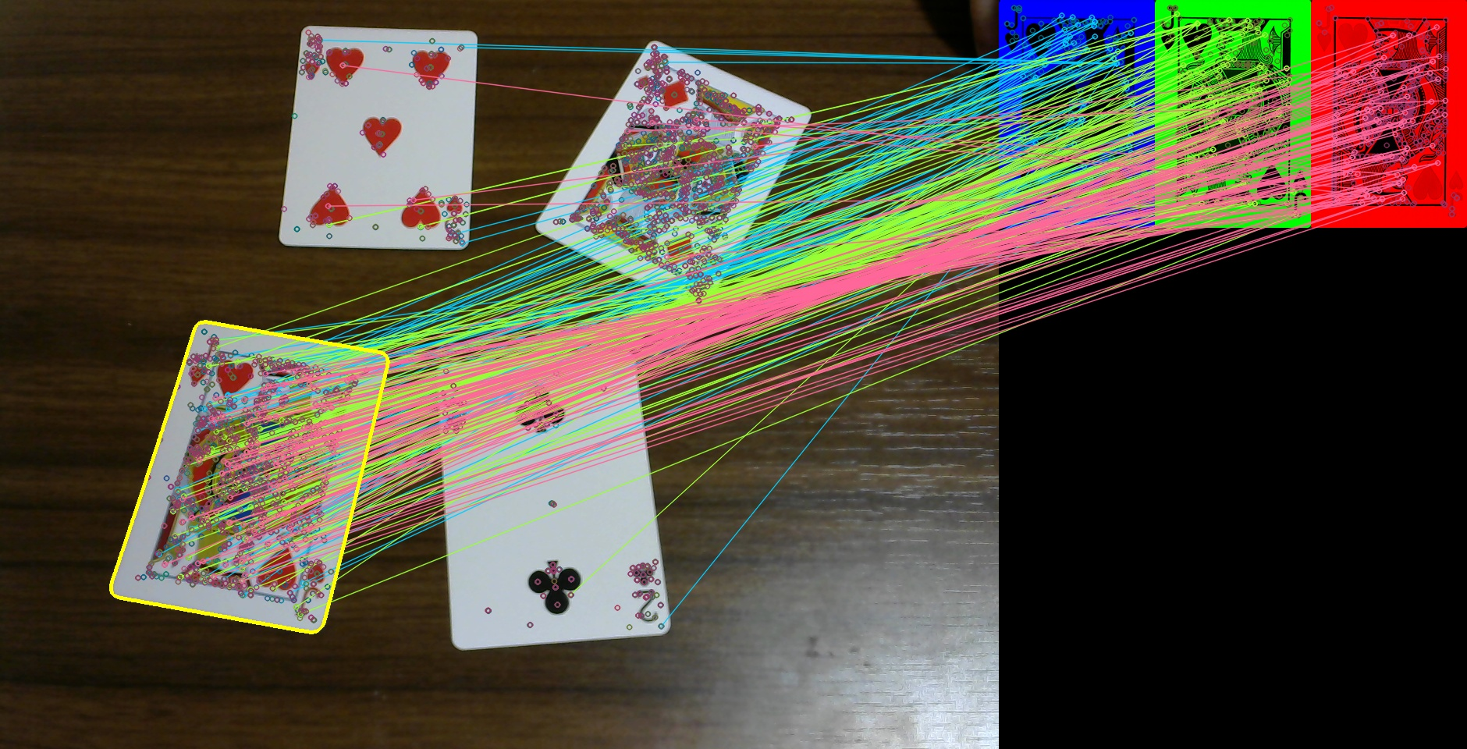
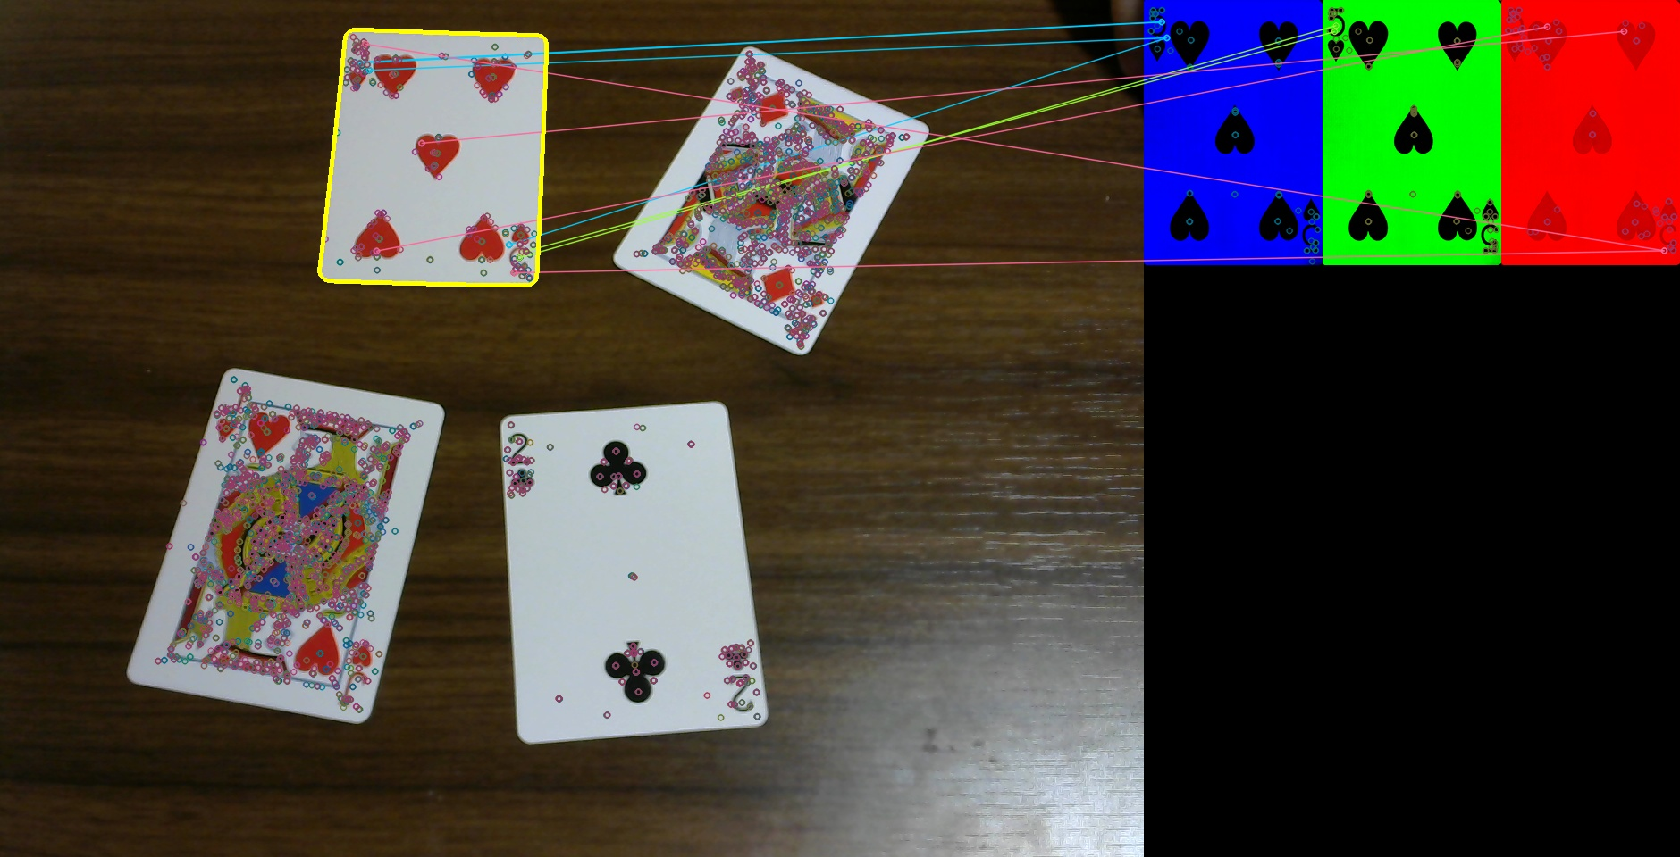


Slide 6
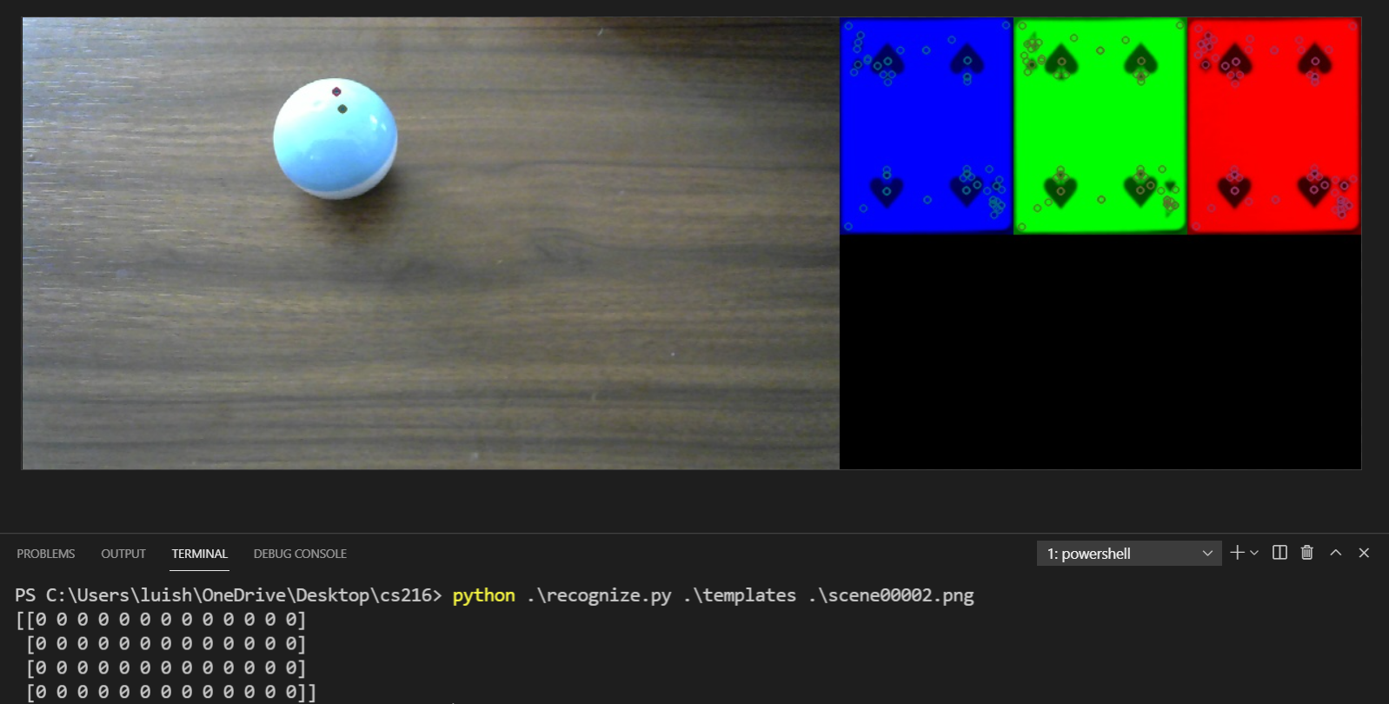
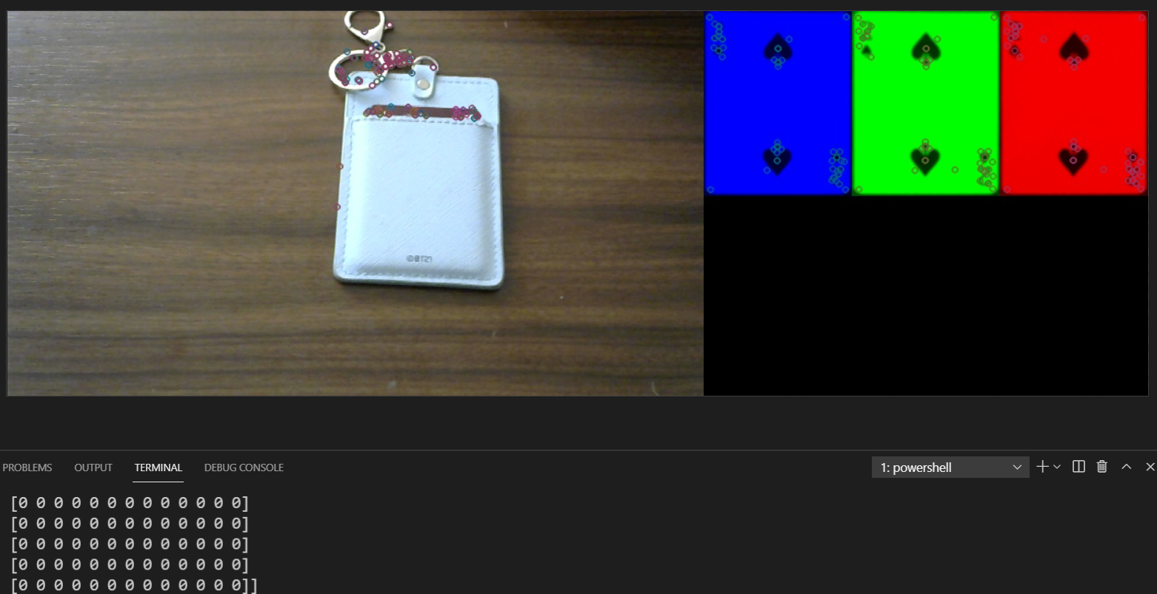
Result

Slide 7
Conclution
Proud:
Apply the aspects learned from lecture
Template detection in a light-weight but precise way
Challenge:
Generate mask to improve SIFT accuracy
Come up with the recognition matrix method to recognize cards

